Slide 1

Virtual learning
Back to school night
SCOTT MINCHEW

Slide 2
Introduction
It's a new day at Ridgeland High School and I am proud to be a part of the Titan family!
I earned my B.A. degree from Miss. State University in Kinesiology. I am also certified in General Science and Driver's Education.
This is my 24th year teaching and I still enjoy teaching and learning especially in Madison County schools.
This is my 5th year at Ridgeland High School where every day is a great day to be a Titan!

Slide 3
Successful Learning Environment
Quiet and isolated area.
Minimal or no distractions.
School appropriate clothing.
Be respectful at all times.
Participate and ask questions.

Slide 4
Schedule

Slide 5
Attendance
In order to be considered “present” for Virtual Learning, students must attend live meetings and/or complete classwork. If your student is unable to attend a live meeting, he or she may still be counted “present” as long as classwork due that day is submitted by 11:59 p.m. of the same day.

Slide 6
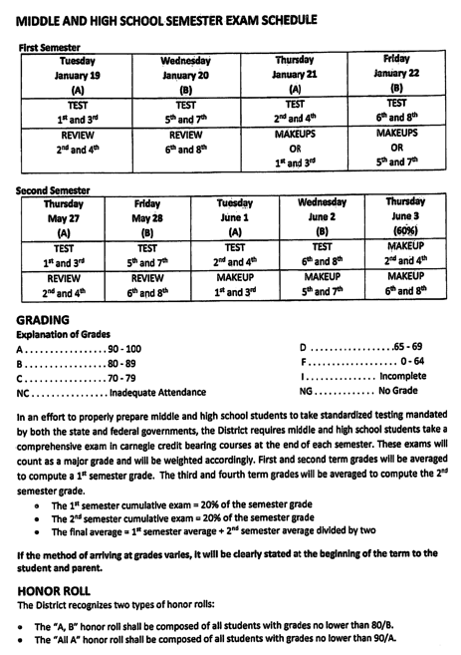
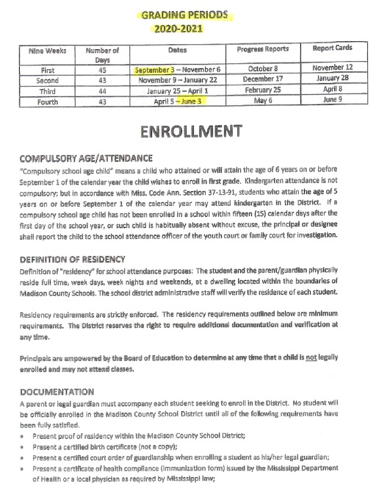
Grading Periods

Slide 7
Class
1st block Earth and Space Science Virtual Learning Block
1st block has a Teams Meeting every A-Day from 8:20 – 9:54
In order to receive the maximum benefits from this class, all students are encouraged to attend live meetings
Students are notified or invited to meetings via their Student Emails
The general structure of the meeting is as follows: Bellringer, Lecture, Guided Practice, and Independent Work

Slide 8
Virtual Student Meals
5 Day Meal Packs will be distributed at your child’s school every Monday from 10am – 12am.
Meals are currently FREE, but they must be pre-ordered.
You can find more information at:
www.madison-schools.com/virtuallearning

Slide 9
Contact Information
Our goal is to maintain an open line of communication as we work together to provide the best education possible for your child.
Please feel free to contact me at sminchew@madison-schools.com
More information regarding Virtual Learning, including contact information, can be found at www.madison-schools.com/virtuallearning

Slide 10

Thank you for entrusting us with the education of your child. We look forward to a great semester!

